Slide 1
LENDING CLUB

Slide 2
Index
Introduction
Problem Statement
Data Preparation
EDA
Model Evaluation

Slide 3
INTRODUCTION
Lending Club uses technology to operate its online credit marketplace at a lower cost than traditional lending programs, passing the savings on to borrowers in the form of lower rates, and offering investors the potential for competitive returns.
By providing borrowers with better rates, LendingClub has earned among the highest satisfaction ratings in the financial services industry.

Slide 4
Problem Statement
How the interest rate charged on a loan is affected by credit history, loan amount and other parameters provided in the dataset

Slide 5
Data Preparation
Removing %, months from columns and converting into numeric
Removing empty columns
We also removed columns having more than 50% null values
We converted 4 categorical columns into numeric using One hot encoding

Slide 6
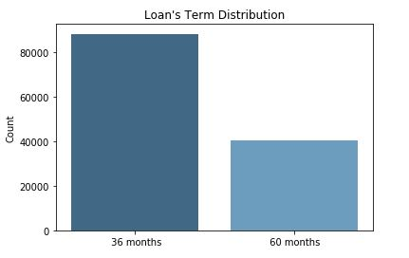
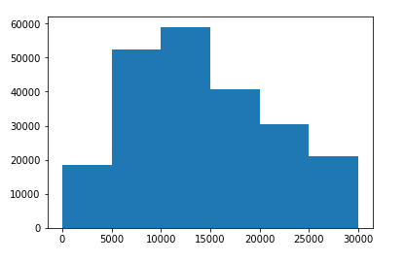
EDA
Loan's Term Distribution Loan Amount Distribution

Slide 7
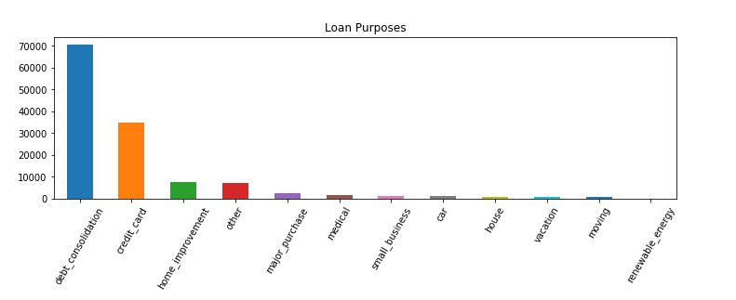
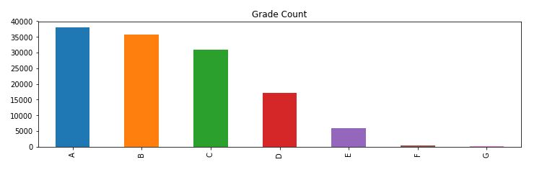
Grade Count Loan Purpose

Slide 8
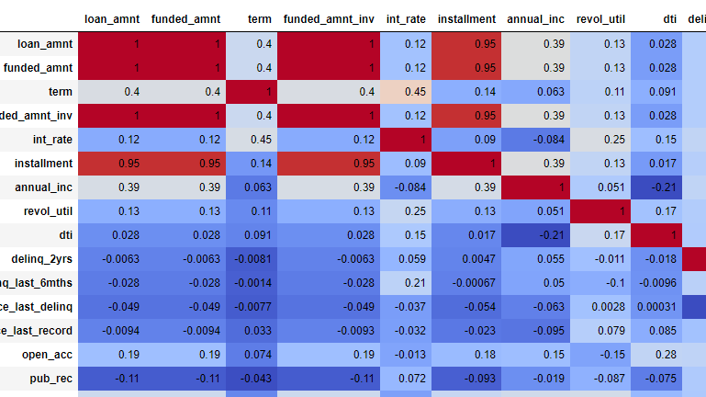
Checking Correlation
We Removed columns with multicollinearity

Slide 9
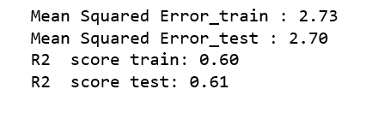
Model Evaluation
Base model

Slide 10
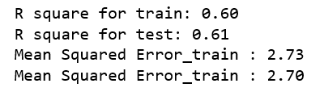
Model Evaluation
Model 2 after LASSO Regularization

Slide 11
Thank You

